Slide 1
Advanced SQL
— Chapter 5
2021年9月
叶文
yewen@bupt.edu.cn
School of Computer Science (National Pilot Software Engineering School)

Slide 2
Outline
Accessing SQL From a Programming Language
Functions and Procedures
Triggers
Recursive Queries
Advanced Aggregation Features
ODBC, JDBC, embedded SQL
complex control flow in SQL programs
Conditional-event-action scheme for integrity maintainence
transitive closure queries, iteration
ranking, windowing

Slide 3
5.1 Accessing SQL From a Programming Language
API (application-program interface) for a program to interact with a database server
Application conducts complex data processing, and makes calls to
Connect with the database server
Send SQL commands to the database server
Fetch tuples of result one-by-one into program variables

Slide 4
API, e.g.ODBC, JDBC, embedded SQL
Client
Application program 1
DB file
Server
Application program 1
DBMS
…
DB query language
e.g. SQL
Users
DBMS
DB
DBS/DBAS
Fig.5.0.1 DBS and DBAS

Slide 5
Accessing SQL From a Programming Language
There are two approaches to accessing SQL from a general-purpose programming language
Dynamic SQL
a general-purpose program can connect to and communicate with a database server using a collection of functions (for procedural languages) or methods (for object-oriented languages)
dynamic SQL allows the program to construct an SQL query as a character string at runtime, submit the query, and then retrieve the result into program variables a tuple at a time
JDBC (Java Database Connectivity) works with Java
ODBC (Open Database Connectivity) works with C, C++, C#, and Visual Basic
Other API’s such as ADO.NET sit on top of ODBC
Embedded SQL
the SQL statements in high-level programming language programs are translated at compile time into function calls
at runtime, these function calls connect to the database using an API that provides dynamic SQL facilities

Slide 6
5.1.1 JDBC
JDBC is a Java API for communicating with database systems supporting SQL.
JDBC supports a variety of features for querying and updating data, and for retrieving query results.
JDBC also supports metadata retrieval, such as querying about relations presented in the database and the names and types of relation attributes
SQL injection
Model for communicating with the database:
Open a connection
Create a “SQL statement” object
Execute queries using the Statement object to send queries and fetch results
Exception mechanism to handle errors

Slide 7
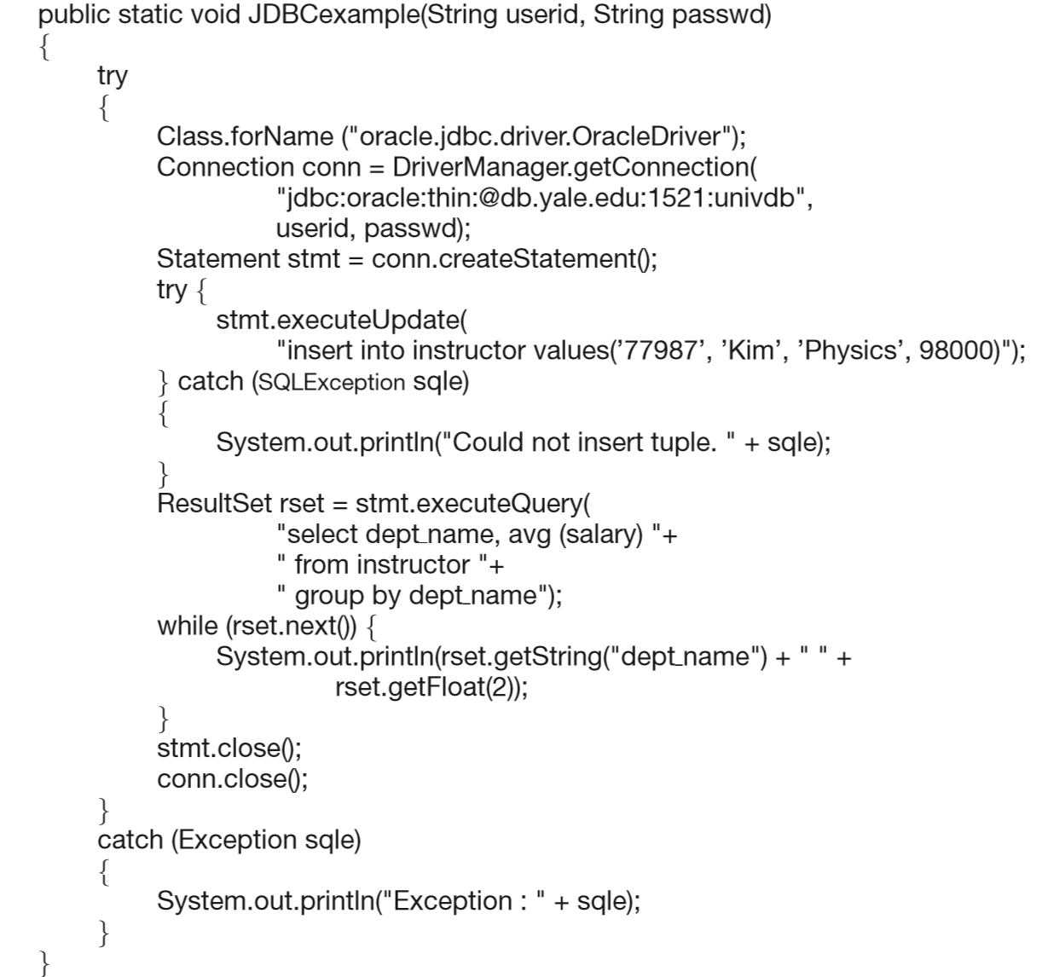
1.选择JDBC驱动，Fig.5.0.2
2.创建连接
class: DriverManager
method: getConnection
object: statement
handle: stmt
URL/machine to be connected
连接名字
3.创建语句stmt
Statement handle
5. 捕获异常
4.Ship SQL query through stmt to DBMS
结果集
6.判断是否有数据，取结果，输出
Fig.5.1 JDBC Code for
Older Versions of Java/JDBC
7.关闭语句、连接

Slide 8
public static void JDBCexample(String dbid, String userid, String passwd)
{
try {
Class.forName ("oracle.jdbc.driver.OracleDriver");
Connection conn = DriverManager.getConnection( "jdbc:oracle:thin:@db.yale.edu:2000:univdb", userid, passwd);
Statement stmt = conn.createStatement();
… Do Actual Work ….
stmt.close();
conn.close();
}
catch (SQLException sqle) {
System.out.println("SQLException : " + sqle);
}
} NOTE: Class.forName is not required from JDBC 4 onwards. The try with resources syntax in prev slide is preferred for Java 7 onwards.

Slide 9
Update to database try { stmt.executeUpdate( "insert into instructor values('77987', 'Kim', 'Physics', 98000)"); } catch (SQLException sqle) { System.out.println("Could not insert tuple. " + sqle); }
Execute query and fetch and print results
ResultSet rset = stmt.executeQuery( "select dept_name, avg (salary) from instructor group by dept_name"); while (rset.next()) { System.out.println(rset.getString("dept_name") + " " + rset.getFloat(2)); }

Slide 10
JDBC
Open a connection, named as conn
using the getConnection method of the DriverManager class
parameters
URL/machine to be connected;
user identifier, password;
Create a SQL “statement” object on the connection conn
using the createStatement method
its statement handle is named as stmt
allows the Java program to invoke methods that ship an SQL statement given as an argument for execution by the DBMS

Slide 11
JDBC
Execute queries using the Statement object stmt to send queries and fetch results
using execute.query or execute.update such as insert/delete/update/createtable,
parameters
the SQL statement to be executed, represented as a string
using the try{…}/catch{…}construct to catch any exceptions or error conditions
Fetch the query result
retrieve the set of tuples in the result into a ResultSet object rset, and fetch them one tuple at a time
the next() method tests whether or not the result set has at least one tuple and if so, fetches it
At the end of the query, the statement stmt and the connection conn are closed

Slide 12
JDBC Code Details
Getting result fields:
rs.getString(“dept_name”) and rs.getString(1) equivalent if dept_name is the first argument of select result.
Dealing with Null values
int a = rs.getInt(“a”);
if (rs.wasNull()) Systems.out.println(“Got null value”);

Slide 13
JDBC SUBSECTIONS: in addtion
[ Connecting to the Database
Shipping SQL Statements to the Database System
Exceptions and Resource Management
Retrieving the Result of a Query
]
Prepared Statements
Callable Statements
Metadata Features
Other Features
Database Access from Python

Slide 14
Prepared Statement
Create a prepared statement in which some values are replaced by “?”, thereby specifying that actual values will be provided later
The database system compiles the query when it is prepared. Each time the query is executed (with new values to replace the “?”s), the database system can reuse the previously compiled form of the query and apply the new values as parameters
The setString() method and other similar methods such as setInt() for other basic SQL types allow us to specify the values for the parameters
The ﬁrst argument speciﬁes the “?” parameter for which we are assigning a value (the ﬁrst parameter is 1, unlike most other Java constructs, which start with 0). The second argument speciﬁes the value to be assigned

Slide 15
Prepared Statement
Create a prepared statement in which some values are replaced by “?”, thereby specifying that actual values will be provided later
Each time
PreparedStatement pStmt = conn.prepareStatement( "insert into instructor values(?,?,?,?)");
pStmt.setString(1, "88877"); pStmt.setString(2, "Perry"); pStmt.setString(3, "Finance"); pStmt.setInt(4, 125000);
pStmt.executeUpdate(); pStmt.setString(1, "88878"); pStmt.executeUpdate();
instructor(ID, name, dept name, salary)
an object of class
class
method
1. the ﬁrst argument speciﬁes the “?” parameter for which we are assigning a value
2. the second argument speciﬁes the value to be assigned
前4条语句设置insert的输入为： values(88877, Perry, Finance, 125000)
，但没有出发insert的执行
将 ID重新改为“88878”，并触发执行
insert into instructor values(88878, Perry, Finance, 125000)

Slide 16
Prepared Statement
WARNING: 避免SQL注入
always use prepared statements when taking an input from the user and adding it to a query
NEVER create a query by concatenating strings
不要通过拼接字符串来构造SQL查询
"insert into instructor values(' " + ID + " ', ' " + name + " ', " + " ' + dept name + " ', " ' balance + ')“
What if name is “O’Henry”?
The query string would have a syntax error
It is quite possible that an instructor name may have a quotation mark in its name (for example, “O’Henry”)

Slide 17
SQL Injection
Suppose query is constructed using
"select * from instructor where name = '" + name + "'"
Suppose the user, instead of entering a name, enters:
X' or 'Y' = 'Y
then the resulting statement becomes:
"select * from instructor where name = '" + "X' or 'Y' = 'Y" + "'"
which is:
select * from instructor where name = 'X' or 'Y' = 'Y’
User could have even used
X'; update instructor set salary = salary + 10000; --
always true, 导致可查询出instructor中所有元组

Slide 18
SQL Injection
Prepared statement internally uses: "select * from instructor where name = 'X\' or \'Y\' = \'Y’
which is harmless and returns the empty relation
Programmers must pass user-input strings to the database only through parameters of prepared statements;
creating SQL queries by concatenating strings with user-input values is an extremely serious security risk and should never be done in any program

Slide 19
Metadata Features
ResultSet metadata
E.g. after executing query to get a ResultSet rs:
ResultSetMetaData rsmd = rs.getMetaData();
for(int i = 1; i <= rsmd.getColumnCount(); i++) {
System.out.println(rsmd.getColumnName(i));
System.out.println(rsmd.getColumnTypeName(i));
}
How is this useful?
获取查询结果集中列的数目（结果关系的属性总数）；
输出各列的列名、数据类型

Slide 20
Metadata (Cont)
Database metadata
DatabaseMetaData dbmd = conn.getMetaData();
// Arguments to getColumns: Catalog, Schema-pattern, Table-pattern, // and Column-Pattern // Returns: One row for each column; row has a number of attributes // such as COLUMN_NAME, TYPE_NAME // The value null indicates all Catalogs/Schemas. // The value “” indicates current catalog/schema // The value “%” has the same meaning as SQL like clause
ResultSet rs = dbmd.getColumns(null, "univdb", "department", "%");
while( rs.next()) {
System.out.println(rs.getString("COLUMN_NAME"),
rs.getString("TYPE_NAME");
}
And where is this useful?

Slide 21
Finding Primary Keys
DatabaseMetaData dmd = connection.getMetaData(); // Arguments below are: Catalog, Schema, and Table // The value “” for Catalog/Schema indicates current catalog/schema // The value null indicates all catalogs/schemas ResultSet rs = dmd.getPrimaryKeys(“”, “”, tableName); while(rs.next()){ // KEY_SEQ indicates the position of the attribute in // the primary key, which is required if a primary key has multiple // attributes System.out.println(rs.getString(“KEY_SEQ”), rs.getString("COLUMN_NAME"); }

Slide 22
Transaction Control in JDBC
By default, each SQL statement is treated as a separate transaction that is committed automatically
bad idea for transactions with multiple updates
Can turn off automatic commit on a connection
conn.setAutoCommit (false);
Transactions must then be committed or rolled back explicitly
conn.commit(); or
conn.rollback();
conn.setAutoCommit(true) turns on automatic commit.

Slide 23
Other JDBC Features
Calling functions and procedures
CallableStatement cStmt1 = conn.prepareCall("{? = call some function(?)}");
CallableStatement cStmt2 = conn.prepareCall("{call some procedure(?,?)}");
Handling large object types
getBlob() and getClob() that are similar to the getString() method, but return objects of type Blob and Clob, respectively
get data from these objects by getBytes()
associate an open stream with Java Blob or Clob object to update large objects
blob.setBlob(int parameterIndex, InputStream inputStream).

Slide 24
Embedded SQL: SQLJ in Java
JDBC is overly dynamic, errors cannot be caught by compiler
SQLJ: embedded SQL in Java
#sql iterator deptInfoIter ( String dept name, int avgSal); //定义查询结果关系
deptInfoIter iter = null;
#sql iter = { select dept_name, avg(salary) from instructor //嵌入式SQL语句
group by dept name };
while (iter.next()) {
String deptName = iter.dept_name(); //利用指针依次输出查询结果关系中各行
int avgSal = iter.avgSal();
System.out.println(deptName + " " + avgSal);
}
iter.close();

Slide 25
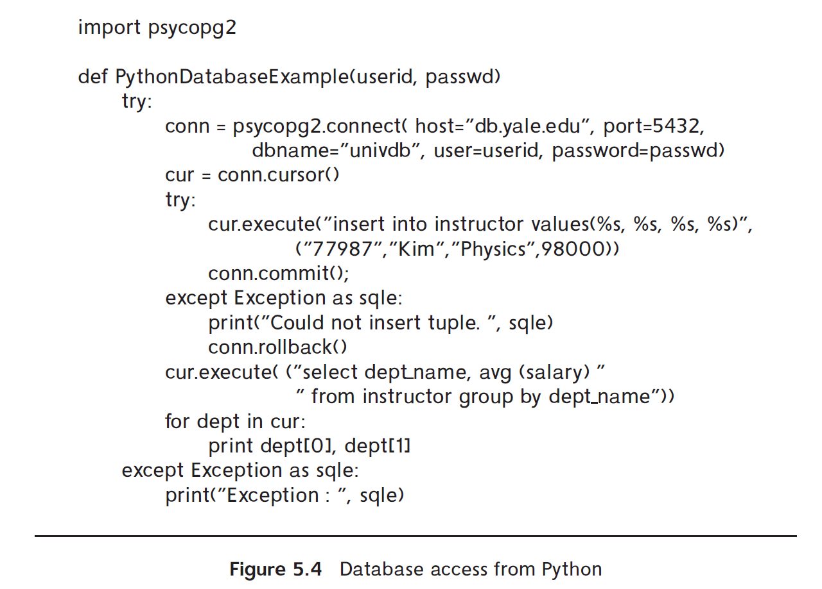
Database Access from Python

Slide 26
5.1.3 ODBC
Open DataBase Connectivity (ODBC) standard
standard for application programs (as clients) to communicate with a database server.
application program interface (API) to
open a connection with a database,
send queries and updates,
get back results.
Applications such as GUI, spreadsheets, etc. can use ODBC
Architecture of ODBC
refer to Fig. 5.0.2
ODBC利用driver来适应不同厂家数据库的物理结构，如分块大小、访问方式

Slide 27
Data Source
Name
Database application programs
Application
Level
ODBC API
ODBC manager
ODBC
Level
ODBC driver manager
SQL Server
driver
Oracle
driver
MySQL
driver
PostgreSQL
driver
other DB
driver
SQL
Server
Oracle
MySQL
PGSQL
other
DBMS
Data Source
Level
Fig.5.0.2 ODBC Architecture

Slide 28
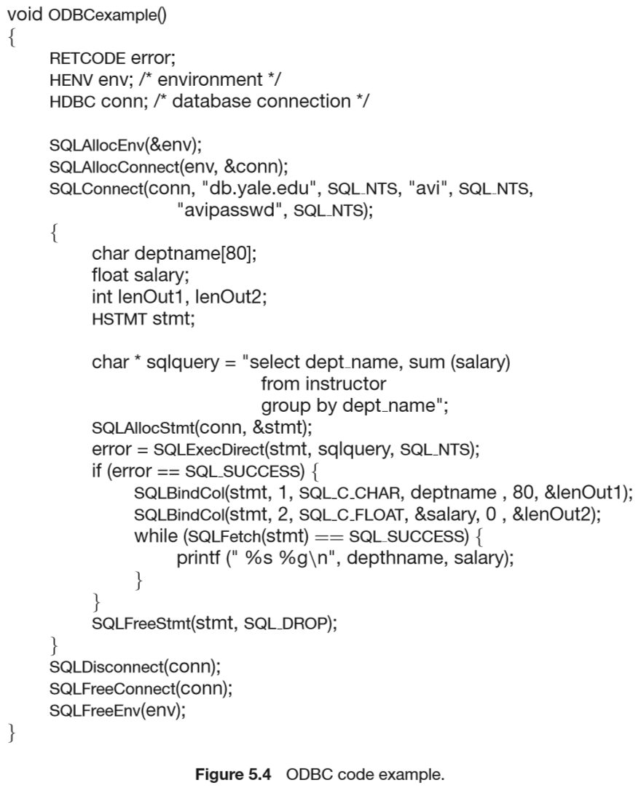
DBMS执行SQL query后的返回码(to client)：成功，失败
0. Types and variables declaration in ODBC
1.分配SQL环境
connection handle
SQLConnect参数
2.分配连接
连接句柄: conn
连接的服务器: db.yale.edu
用户标识: avi
用户口令: avipassword
3.打开连接
SQL_NTS: the previous argument is a null-terminated string
4. 定义C variables、SQL语句句柄
statement handle
5.分配语句
Query
6.Send SQL to the DBMS through statement
7. 将查询结果tuple中的属性绑定到C variables
SQLBindCo参数
1: 语句, e.g.stmt;
2: 查询结果tuple中属性位置，e.g. 1,2;
3: SQL attribute 类型 → C variable 类型转换;
4：the address of the C variable;
5/6：对变长（字符串）类型，定义最大长度，以及实际长度的存储位置/变量
8. 从查询结果中依次取各个结果tuple
9.结束：
释放语句
断开连接
释放连接
释放环境
Fig. 5.4 ODBC code example in C program

Slide 29
关于连接时长
实际数据库平台下，client application program与DBMS间的连接(connection)的时长是有限制、并且可以调整的
建立连接、数据库访问时，如果不指定连接时长，可采用系统默认的连接时长
注意：
当采用系统默认连接时长时，e.g.60s，如果在连接过程中的SQL query操作访问时间超过该连接时长，则SQL query操作将被强行终止，访问失败
可以采用相关API，修改连接时长，保证数据库访问时间不超过连接时长

Slide 30
5.1.4 Embedded SQL
Approaches to take SQL as DB query tools
interactive SQL
SQL is used directly as DML and DDL through DBS human-machine interfaces
dynamic SQL, e.g JDBC, ODBC
embedded SQL
SQL is embedded in general-purpose programming languages, e.g. C language
executing of general-purpose programming language programs with SQL statement embedded results in DB access

Slide 31
Embed SQL
The SQL standard defines embeddings of SQL in a variety of programming languages such as C, C++, Pascal, Fortran, and Cobol
A language to which SQL queries are embedded is referred to as a host language(宿主语言), and the SQL structures permitted in the host language comprise embedded SQL
Merits of embedded SQL
交互式SQL只能进行DB的访问操作，不能对DB访问结果进行进一步的数据处理
Embedded SQL将SQL的数据库访问功能与C语言等宿主语言的数据处理能力相结合，提高了数据应用系统的能力

Slide 32
Embedded SQL
EXEC SQL statement is used to identify embedded SQL request to the preprocessor
EXEC SQL <embedded SQL statement >;
Note: this varies by language:
In some languages, like COBOL, the semicolon is replaced with END-EXEC
In Java embedding uses # SQL { …. };

Slide 33
Embedded SQL (Cont.)
Before executing any SQL statements, the program must first connect to the database. This is done using:
EXEC-SQL connect to server user user-name using password;
Here, server identifies the server to which a connection is to be established.

Slide 34
Embedded SQL (Cont.)
Variables of the host language can be used within embedded SQL statements. They are preceded by a colon (:) to distinguish from SQL variables
e.g., :credit_amount
Variables used as above must be declared within DECLARE section, as illustrated below. The syntax for declaring the variables, however, follows the usual host language syntax.
EXEC-SQL BEGIN DECLARE SECTION}
int credit-amount ;
EXEC-SQL END DECLARE SECTION;

Slide 35
Embedded SQL (Cont.)
E.g.1 From within a host language, find the ID and name of students who have completed more than the number of credits stored in variable credit_amount in the host langue
credit_amount is the shared variable defined in the declaration part
C program
EXEC SQL BEGIN DECLARE SECTION
int credit_amount;
EXEC SQL END DECLARE SECTION
credit_amount := e.g. input-from-screen-by-users
EXEC SQL
select ID, name
from student
where tot_cred > :credit_amount
END-EXEC
shared variable defined in host language

Slide 36
Cursor in Embedded SQL
游标
To write an embedded SQL query, we use the
declare c cursor for <SQL query>
statement.
The variable c is used to identify the query
EXEC SQL
declare c cursor for select ID, name from student where tot_cred > :credit_amount
END_EXEC

Slide 37
why using Cursor in Embedded SQL
*利用Embedded SQL进行查询时，查询结果有可能包括多个元组，此时无法直接将多个元组通过共享变量赋值传递给宿主程序
*系统开辟专门working区域存放SQL查询的结果关系，并利用查询游标c指向此区域。宿主程序根据c指向的查询结果关系集合，使用open, fetch, close依次获取结果关系中的各元组

Slide 38
EXEC SQL BEGIN DECLARE SECTION
int credit_amount;
char si, sn;
EXEC SQL END DECLARE SECTION
credit_amount:= input-from-screen-by-users
EXEC SQL
declare c cursor for
select ID, name from student where tot_cred > :credit_amount
END-EXEC
EXEC SQL open c END-EXEC
EXEC SQL fetch c into :si, :sn END-EXEC
EXEC SQL close c END-EXEC
Example 2
可以用循环语句依次
取走全部查询结果
shared variable

Slide 39
Cursor in Embedded SQL (cont.)
Usage of cursor in embedded SQL
declare cursor – open – fetch - close
application program:
open
fetch
close
SQL query
cursor
working area
DBS
results
…
Fig. 5.0.3 Cursor in Embedded SQL

Slide 40
Cursor in Embedded SQL (cont.)
The open statement for our example is as follows:
EXEC SQL open c
This statement causes the database system to execute the query and to save the results within a temporary relation. The query uses the value of the host-language variable credit-amount at the time the open statement is executed.
The fetch statement causes the values of one tuple in the query result to be placed on host language variables.
EXEC SQL fetch c into :si, :sn END_EXEC
Repeated calls to fetch get successive tuples in the query result

Slide 41
Cursor in Embedded SQL (cont.)
A variable called SQLSTATE in the SQL communication area (SQLCA) gets set to ‘02000’ to indicate no more data is available
The close statement causes the database system to delete the temporary relation that holds the result of the query
EXEC SQL close c
Note
above details vary with language
for example, the Java embedding defines Java iterators to step through result tuples.

Slide 42
Updates Through Embedded SQL
Embedded SQL expressions for database modification (update, insert, and delete)
Can update tuples fetched by cursor by declaring that the cursor is for update
EXEC SQL
declare c cursor for select * from instructor where dept_name = ‘Music’ for update
Add 1000 to the salary attribute of every instructor in the Music department
We then iterate through the tuples by performing fetch operations on the cursor (as illustrated earlier), and after fetching each tuple we execute the following code:
update instructor set salary = salary + 1000 where current of c

Slide 43
5.2 Functions and Procedures
SQL:1999 supports functions and procedures
Functions/procedures can be written in SQL itself, or in an external programming language (e.g., C, Java).
Functions written in an external languages are particularly useful with specialized data types such as images and geometric objects.
Example: functions to check if polygons overlap, or to compare images for similarity, e.g. in OpenCV
Some database systems support table-valued functions, which can return a relation as a result.
SQL:1999 also supports a rich set of imperative constructs, including
Loops, if-then-else, assignment
Many databases have proprietary procedural extensions to SQL that differ from SQL:1999.

Slide 44
Example: SQL Function
Define a function that, given the name of a department, returns the count of the number of instructors in that department.
create function dept_count (dept_name varchar(20)) returns integer begin declare d_count integer; select count (* ) into d_count from instructor where instructor.dept_name = dept_name return d_count; end

Slide 45
Example: SQL Functions
The function dept_count can be used to find the department names and budget of all departments with more that 12 instructors.
select dept_name, budget from department where dept_count (dept_name ) > 12

Slide 46
SQL Procedures
The dept_count function could instead be written as procedure:
create procedure dept_count_proc (in dept_name varchar(20), out d_count integer) begin
select count(*) into d_count from instructor where instructor.dept_name = dept_count_proc.dept_name
end

Slide 47
SQL Procedures
Procedures can be invoked either from an SQL procedure or from embedded SQL, using the call statement.
declare d_count integer; call dept_count_proc( ‘Physics’, d_count);
Procedures and functions can be invoked also from dynamic SQL
函数、存储过程预先生成对应的查询执行计划（类似于目标代码），存储在DBMS中，应用程序直接调用，不需再进行查询处理和优化（i.e.编译）

Slide 48
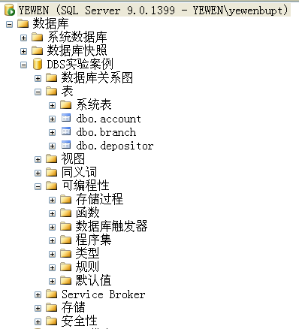
Functions and Procedures (cont.)
The functions and procedures defined are stored in DBS, and can be called by SQL statements or programs

Slide 49
Language Constructs for Procedures & Functions
略
SQL supports constructs that gives it almost all the power of a general-purpose programming language.
warning:
most database systems implement their own variant of the standard syntax below.
Compound statement: begin … end,
May contain multiple SQL statements between begin and end.
Local variables can be declared within a compound statements
知乎、CSDN讨论帖：
是否需要存储过程？

Slide 50
Language Constructs
While and repeat statements:
while boolean expression do
sequence of statements ;
end while
repeat
sequence of statements ;
until boolean expression
end repeat
Conditional statements (if-then-else)
if boolean expression then statement or compound statement elseif boolean expression then statement or compound statement else statement or compound statement end if

Slide 51
Language Constructs
For loop
Permits iteration over all results of a query
Example: Find the budget of all departments declare n integer default 0; for r as select budget from department do set n = n + r.budget end for

Slide 52
Example procedure
Registers student after ensuring classroom capacity is not exceeded
Returns 0 on success and -1 if capacity is exceeded
See book (page 202) for details
Signaling of exception conditions, and declaring handlers for exceptions
declare out_of_classroom_seats condition declare exit handler for out_of_classroom_seats begin … end
The statements between the begin and the end can raise an exception by executing “signal out_of_classroom_seats”
The handler says that if the condition arises he action to be taken is to exit the enclosing the begin end statement.

Slide 53
External Language Routines
SQL allows us to define functions in a programming language such as Java, C#, C or C++.
Can be more efficient than functions defined in SQL, and computations that cannot be carried out in SQL\can be executed by these functions.
Declaring external language procedures and functions
create procedure dept_count_proc(in dept_name varchar(20), out count integer) language C external name '/usr/avi/bin/dept_count_proc' create function dept_count(dept_name varchar(20)) returns integer language C external name '/usr/avi/bin/dept_count'

Slide 54
External Language Routines (Cont.)
Benefits of external language functions/procedures:
more efficient for many operations, and more expressive power.
Drawbacks
Code to implement function may need to be loaded into database system and executed in the database system’s address space.
risk of accidental corruption of database structures
security risk, allowing users access to unauthorized data
There are alternatives, which give good security at the cost of potentially worse performance.
Direct execution in the database system’s space is used when efficiency is more important than security.

Slide 55
Security with External Language Routines
To deal with security problems, we can do on of the following:
Use sandbox techniques
That is, use a safe language like Java, which cannot be used to access/damage other parts of the database code.
Run external language functions/procedures in a separate process, with no access to the database process’ memory.
Parameters and results communicated via inter-process communication
Both have performance overheads
Many database systems support both above approaches as well as direct executing in database system address space.

Slide 56
5.3 Trigger (触发器)
Trigger
a statement that is executed automatically by DBMS as a side effect of a modification to the database
As an integrity control mechanism, trigger introduced to SQL standard in SQL:1999, but supported even earlier using non-standard syntax by most databases.
syntax illustrated here may not work exactly on your database system;
check the system manuals

Slide 57
Trigger (cont.)
Trigger is an event-condition-action model based mechanism
for integrity definition, checking, and remedy
specify what events cause the trigger to be executed (e.g. insert, delete, update), and under which conditions the trigger execution will proceed
integrity constraints checking
specify the actions to be taken when the trigger executes
if constraints is violated, remedy actions are taken

Slide 58
Triggering Events and Actions in SQL
Triggering event can be insert, delete or update
Triggers on update can be restricted to specific attributes
for example, after update of takes on grade
Values of attributes before and after an update can be referenced
referencing old row as : for deletes and updates
referencing new row as : for inserts and updates

Slide 59
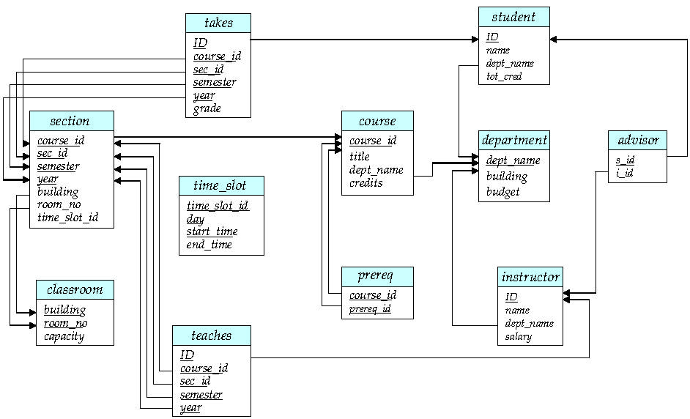
r₂
r₁
Fig. 2.8 Schema Diagram

Slide 60
Triggering Events and Actions in SQL
Triggers can be activated before an event, which can serve as extra constraints.
For example, convert blank grades to null.
create trigger setnull_trigger before update of takes referencing new row as nrow for each row when (nrow.grade = ‘ ‘) begin atomic set nrow.grade = null; end;
优点：
预先编译（查询处理优化），存储在DBMS中，直接调用
当新插入元组中的成绩grade为blank时，将grade替换为null，再插入。
注意：由于是insert操作，不存在old row，只有new row

Slide 61
Trigger to maintain referential integrity
1. 插入section中新元组的time_slot_id必须在timeslot中存在，否则回滚rollback；
2. 删除timeslot中某个已有元组时，该元组的time_slot_id已在section中，并且该元组是具有time_slot_id的唯一/最后一个元组，e.g. <1-2节,星期二,8:00,10:00>，否则回滚
create trigger timeslot_check1 after insert on section referencing new row as nrow //插入的新元组 for each row when nrow.time_slot_id not in ( select time_slot_id
from timeslot) begin atomic rollback
end;
<DBS,9-12班,秋季,2020,教2, 340, 3-5节>
新插入的section的time_slot_id还没有在timeslot中定义

Slide 62
1. 插入section中新元组的time_slot_id必须在timeslot中存在，否则回滚rollback；
2. 删除timeslot中某个已有元组时，该元组的time_slot_id已在section中，并且该元组是具有time_slot_id的唯一/最后一个元组。E.g. <1-2节,星期二,8:00,10:00>
create trigger timeslot_check2 after delete on timeslot referencing old row as orow //删除前的旧元组 for each row when orow.time_slot_id not in ( select time_slot_id
from timeslot) /last tuple for time_slot_id deleted from timeslot
and orow.time_slot_id in ( select time_slot_id
from section) /time_slot_id still referenced from section begin atomic rollback
end;
<1-2节,星期二,8:00,10:00>
in timeslot
不存在另外一个1-2节上课点，
e.g. <1-2节,星期三,8:00,10:00> in timeslot
被删除的timeslot的time_slot_id，e.g. 1-2节，在section中仍然使用, e.g.
<DBS,9-12班,秋季,2020,教2, 340, 1-2节> in section

Slide 63
当通过update takes向takes中填入成绩时，要求更新student表中学生的tot_credits
Example: Trigger to Maintain credits_earned value
create trigger credits_earned after update of takes on (grade) referencing new row as nrow //修改后新成绩元组 referencing old row as orow //修改前旧成绩元组 for each row when nrow.grade <> ’F’ and nrow.grade is not null and (orow.grade = ’F’ or orow.grade is null) begin atomic update student set tot_cred= tot_cred + (select credits from course where course.course_id= nrow.course_id) where student.id = nrow.id; end;
update 之后takes中该门课及格并且有成绩→ 新修完一门课程，并且获得新学分，需要在student.tot_credits中累加新学分
update 之前takes中该门课考试没有通过或没有成绩
被update的学生
被update的课程

Slide 64
Example: 数据导入触发器
例3. 小学期课程设计
数据导入时，利用触发器对导入数据库的数据进行预处理：
1）新数据insert；
2）已有数据：update，或删除旧数据后，再插入新数据

Slide 65
Statement Level Triggers
Instead of executing a separate action for each affected row, a single action can be executed for all rows affected by a transaction
Use for each statement instead of for each row
Use referencing old table or referencing new table to refer to temporary tables (called transition tables) containing the affected rows
Can be more efficient when dealing with SQL statements that update a large number of rows

Slide 66
When Not To Use Triggers
Triggers were used earlier for tasks such as
Maintaining summary data (e.g., total salary of each department)
Replicating databases by recording changes to special relations (called change or delta relations) and having a separate process that applies the changes over to a replica
There are better ways of doing these now:
Databases today provide built in materialized view facilities to maintain summary data
Databases provide built-in support for replication
Encapsulation facilities can be used instead of triggers in many cases
Define methods to update fields
Carry out actions as part of the update methods instead of through a trigger

Slide 67
When Not To Use Triggers (Cont.)
Risk of unintended execution of triggers, for example, when
Loading data from a backup copy
Replicating updates at a remote site
Trigger execution can be disabled before such actions.
Other risks with triggers:
Error leading to failure of critical transactions that set off the trigger
Cascading execution

Slide 68
5.4 Recursive Queries
SQL:1999 permits recursive view definition
Example: find which courses are a prerequisite, whether directly or indirectly, for a specific course, e.g. Data Structure is for Database System Principles with recursive rec_prereq(course_id, prereq_id) as ( select course_id, prereq_id from prereq union select rec_prereq.course_id, prereq.prereq_id, from rec_rereq, prereq where rec_prereq.prereq_id = prereq.course_id ) select ∗ from rec_prereq;
This example view, rec_prereq, is called the transitive closure(传递闭包)of the prereq relation

Slide 69
The Power of Recursion
Recursive views make it possible to write queries, such as transitive closure queries, that cannot be written without recursion or iteration.
Intuition: Without recursion, a non-recursive non-iterative program can perform only a fixed number of joins of prereq with itself
This can give only a fixed number of levels of managers
Given a fixed non-recursive query, we can construct a database with a greater number of levels of prerequisites on which the query will not work
Alternative: write a procedure to iterate as many times as required
See procedure findAllPrereqs in book

Slide 70
The Power of Recursion
Computing transitive closure using iteration, adding successive tuples to rec_prereq
The next slide shows a prereq relation
Each step of the iterative process constructs an extended version of rec_prereq from its recursive definition.
The final result is called the fixed point of the recursive view definition.
Recursive views are required to be monotonic. That is, if we add tuples to prereq the view rec_prereq contains all of the tuples it contained before, plus possibly more

Slide 71
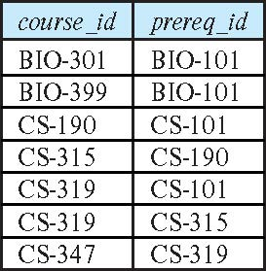
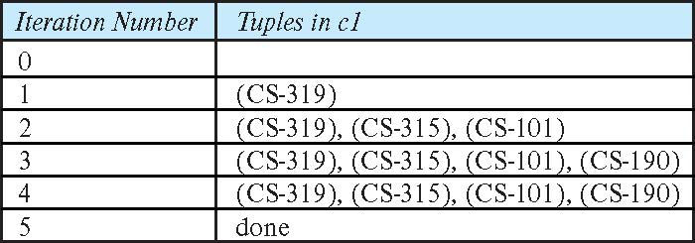
Example of Fixed-Point Computation

Slide 72
5.5 Advanced Aggregation Features
Ranking
finding the position of a value in a set
Windowing
compute an aggregation function over ranges of tuples
window: the range

Slide 73
Ranking
Ranking is done in conjunction with an order by specification.
Suppose we are given a relation student_grades(ID, GPA) giving the grade-point average of each student
Find the rank of each student.
select ID, rank() over (order by GPA desc) as s_rank from student_grades
An extra order by clause is needed to get them in sorted order
select ID, rank() over (order by GPA desc) as s_rank from student_grades order by s_rank
Ranking may leave gaps: e.g. if 2 students have the same top GPA, both have rank 1, and the next rank is 3
dense_rank does not leave gaps, so next dense rank would be 2

Slide 74
Ranking
Ranking can be done using basic SQL aggregation, but resultant query is very inefficient
select ID, (1 + (select count(*) from student_grades B where B.GPA > A.GPA)) as s_rank from student_grades A order by s_rank;

Slide 75
Ranking (Cont.)
Ranking can be done within partition of the data
“Find the rank of students within each department”
select ID, dept_name, rank () over (partition by dept_name order by GPA desc) as dept_rank from dept_grades order by dept_name, dept_rank;
Multiple rank clauses can occur in a single select clause.
Ranking is done after applying group by clause/aggregation
Can be used to find top-n results
More general than the limit n clause supported by many databases, since it allows top-n within each partition

Slide 76
Ranking (Cont.)
Other ranking functions:
percent_rank (within partition, if partitioning is done)
cume_dist (cumulative distribution)
fraction of tuples with preceding values
row_number (non-deterministic in
SQL:1999 permits the user to specify nulls first or nulls lapresence of duplicates)st
select ID, rank ( ) over (order by GPA desc nulls last) as s_rank from student_grades

Slide 77
Ranking (Cont.)
For a given constant n, the ranking the function ntile(n) takes the tuples in each partition in the specified order, and divides them into n buckets with equal numbers of tuples.
E.g.,
select ID, ntile(4) over (order by GPA desc) as quartile from student_grades;

Slide 78
Windowing
Windowing
compute an aggregation function over ranges of tuples
window: the range
Used to smooth out random variations.
E.g., moving average: “Given sales values for each date, calculate for each date the average of the sales on that day, the previous day, and the next day”
Window specification in SQL:
Given relation sales(date, value)
select date, sum(value) over (order by date between rows 1 preceding and 1 following) from sales

Slide 79
Windowing (Cont.)
Examples of other window specifications:
between rows unbounded preceding and current
rows unbounded preceding
range between 10 preceding and current row
All rows with values between current row value –10 to current value
range interval 10 day preceding
Not including current row

Slide 80
Windowing (Cont.)
Can do windowing within partitions
E.g., Given a relation transaction (account_number, date_time, value), where value is positive for a deposit and negative for a withdrawal
“Find total balance of each account after each transaction on the account”
select account_number, date_time, sum (value) over (partition by account_number order by date_time rows unbounded preceding) as balance from transaction order by account_number, date_time

Slide 81
5.6 Data Analysis and OLAP
Online Transaction Processing (OLTP)
Online Analytical Processing (OLAP)
Interactive analysis of data, allowing data to be summarized and viewed in different ways in an online fashion (with negligible delay)
Data that can be modeled as dimension attributes and measure attributes are called multidimensional data.
Measure attributes
measure some value
can be aggregated upon
e.g., the attribute number of the sales relation
Dimension attributes
define the dimensions on which measure attributes (or aggregates thereof) are viewed
e.g., attributes item_name, color, and size of the sales relation

Slide 82
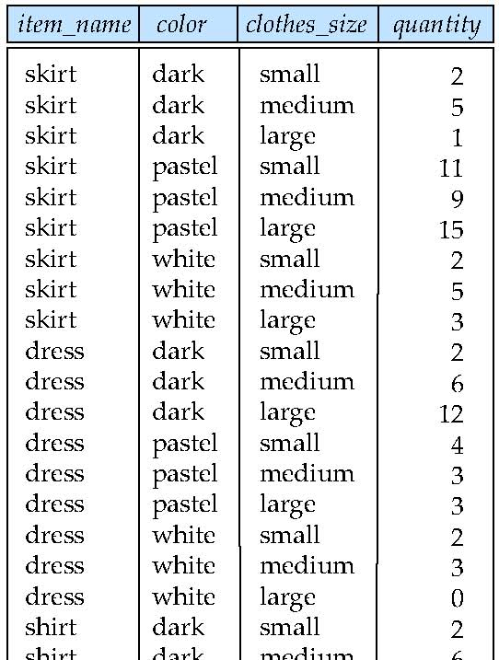
Example sales relation

Slide 83
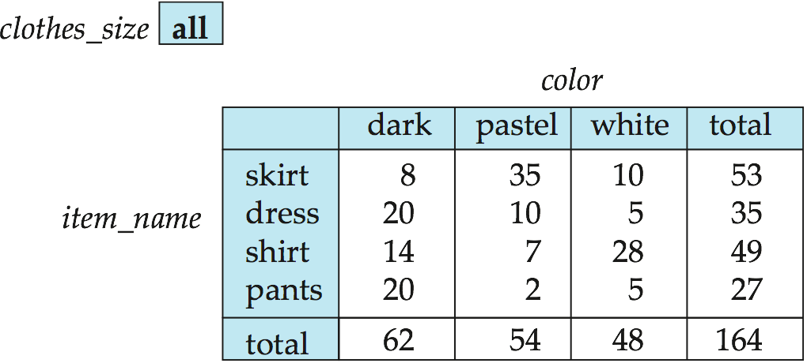
Cross Tabulation of sales by item_name and color
The table above is an example of a cross-tabulation (cross-tab), also referred to as a pivot-table.
Values for one of the dimension attributes form the row headers
Values for another dimension attribute form the column headers
Other dimension attributes are listed on top
Values in individual cells are (aggregates of) the values of the dimension attributes that specify the cell.

Slide 84
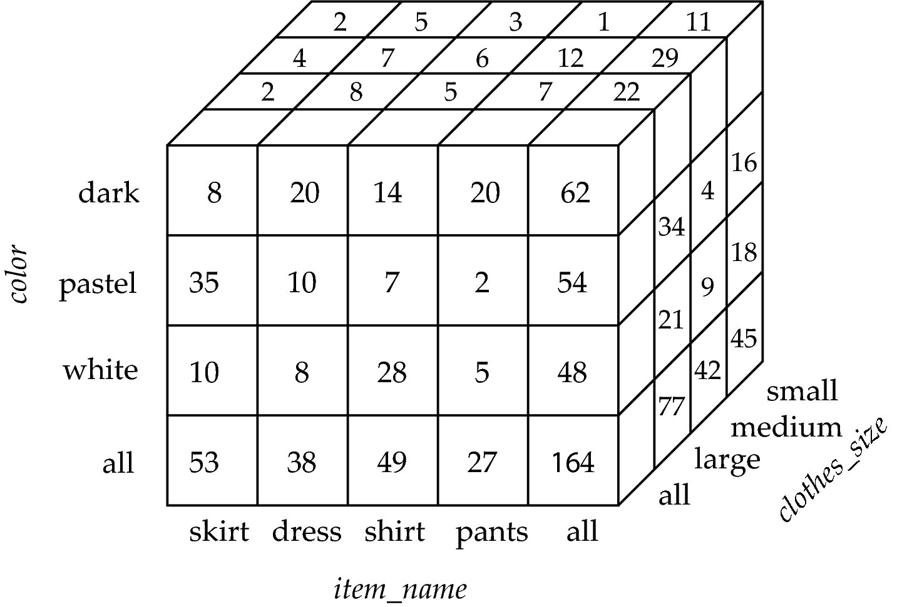
Data Cube
A data cube is a multidimensional generalization of a cross-tab
Can have n dimensions; we show 3 below
Cross-tabs can be used as views on a data cube

Slide 85
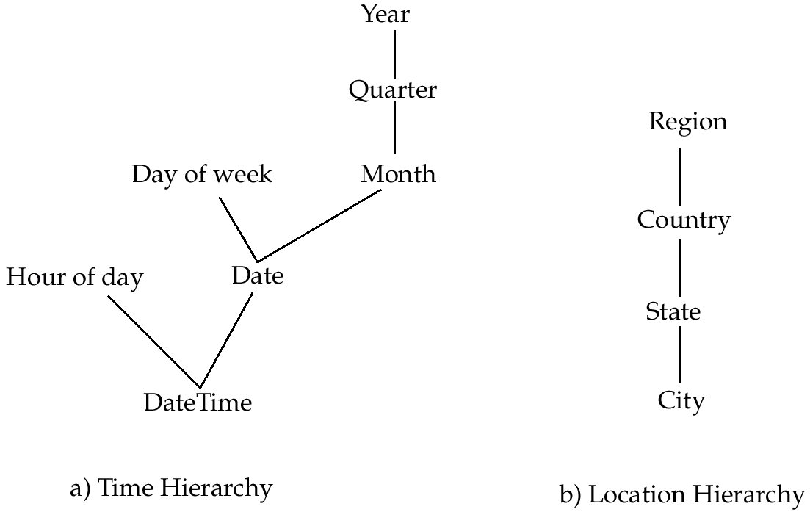
Hierarchies on Dimensions
Hierarchy on dimension attributes
lets dimensions to be viewed at different levels of detail
E.g., the dimension DateTime can be used to aggregate by hour of day, date, day of week, month, quarter or year

Slide 86
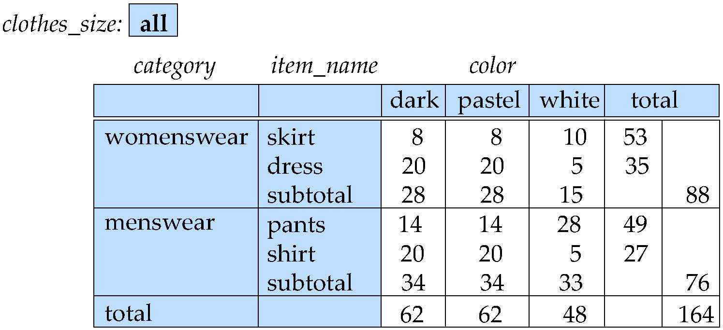
Cross Tabulation With Hierarchy
Cross-tabs can be easily extended to deal with hierarchies
Can drill down or roll up on a hierarchy

Slide 87
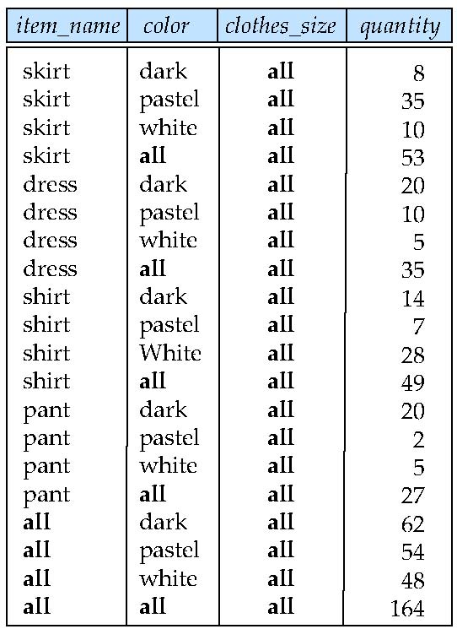
Relational Representation of Cross-tabs
Cross-tabs can be represented as relations
We use the value all is used to represent aggregates.
The SQL standard actually uses null values in place of all despite confusion with regular null values.

Slide 88
Extended Aggregation to Support OLAP
The cube operation computes union of group by’s on every subset of the specified attributes
Example relation for this section sales(item_name, color, clothes_size, quantity)
E.g., consider the query
select item_name, color, size, sum(number) from sales group by cube(item_name, color, size)
This computes the union of eight different groupings of the sales relation:
{ (item_name, color, size), (item_name, color), (item_name, size), (color, size), (item_name), (color), (size), ( ) }
where ( ) denotes an empty group by list.
For each grouping, the result contains the null value for attributes not present in the grouping.

Slide 89
Online Analytical Processing Operations
Relational representation of cross-tab that we saw earlier, but with null in place of all, can be computed by
select item_name, color, sum(number) from sales group by cube(item_name, color)
The function grouping() can be applied on an attribute
Returns 1 if the value is a null value representing all, and returns 0 in all other cases.
select item_name, color, size, sum(number), grouping(item_name) as item_name_flag, grouping(color) as color_flag, grouping(size) as size_flag, from sales group by cube(item_name, color, size)

Slide 90
Online Analytical Processing Operations
Can use the function decode() in the select clause to replace such nulls by a value such as all
E.g., replace item_name in first query by decode( grouping(item_name), 1, ‘all’, item_name)

Slide 91
Extended Aggregation (Cont.)
The rollup construct generates union on every prefix of specified list of attributes
E.g.,
select item_name, color, size, sum(number) from sales group by rollup(item_name, color, size)
Generates union of four groupings:
{ (item_name, color, size), (item_name, color), (item_name), ( ) }
Rollup can be used to generate aggregates at multiple levels of a hierarchy.
E.g., suppose table itemcategory(item_name, category) gives the category of each item. Then
select category, item_name, sum(number) from sales, itemcategory where sales.item_name = itemcategory.item_name group by rollup(category, item_name)
would give a hierarchical summary by item_name and by category.

Slide 92
Extended Aggregation (Cont.)
Multiple rollups and cubes can be used in a single group by clause
Each generates set of group by lists, cross product of sets gives overall set of group by lists
E.g.,
select item_name, color, size, sum(number) from sales group by rollup(item_name), rollup(color, size)
generates the groupings
{item_name, ()} X {(color, size), (color), ()}
= { (item_name, color, size), (item_name, color), (item_name), (color, size), (color), ( ) }

Slide 93
Online Analytical Processing Operations
Pivoting: changing the dimensions used in a cross-tab is called
Slicing: creating a cross-tab for fixed values only
Sometimes called dicing, particularly when values for multiple dimensions are fixed.
Rollup: moving from finer-granularity data to a coarser granularity
Drill down: The opposite operation - that of moving from coarser-granularity data to finer-granularity data

Slide 94
OLAP Implementation
The earliest OLAP systems used multidimensional arrays in memory to store data cubes, and are referred to as multidimensional OLAP (MOLAP) systems.
OLAP implementations using only relational database features are called relational OLAP (ROLAP) systems
Hybrid systems, which store some summaries in memory and store the base data and other summaries in a relational database, are called hybrid OLAP (HOLAP) systems.

Slide 95
OLAP Implementation (Cont.)
Early OLAP systems precomputed all possible aggregates in order to provide online response
Space and time requirements for doing so can be very high
2^{n} combinations of group by
It suffices to precompute some aggregates, and compute others on demand from one of the precomputed aggregates
Can compute aggregate on (item_name, color) from an aggregate on (item_name, color, size)
For all but a few “non-decomposable” aggregates such as median
is cheaper than computing it from scratch
Several optimizations available for computing multiple aggregates
Can compute aggregate on (item_name, color) from an aggregate on (item_name, color, size)
Can compute aggregates on (item_name, color, size), (item_name, color) and (item_name) using a single sorting of the base data

Slide 96

Thanks for your attention

